Slide 1


Intelligent Resume Screening and Analytics System (IRSAS)
Prepared by : Maveron Aguares, Prateek Mishra, Haneen Raffique

Slide 2

The Problem We’re Addressing
Manual or keyword-based resume screening is slow, subjective, inconsistent, and prone to bias
Organizations often deal with hundreds of resumes per role, with pressure to remain fair and compliant
HR requires semantic understanding + transparent reasoning to rid bias and speed up decision making

Slide 3

Our Solution
It combines machine learning and natural language processing to evaluate resumes against job descriptions
IRSAS is an AI-driven resume screening system priortizing fair and explainable hiring
Unlike traditional ATS, it focuses on candidate quality and not solely keyword matching
Explainability is a core principle where every hiring recommendation is accompanied by interpretable justifications

Slide 4

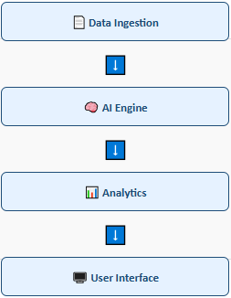
System Architecture
5-Layer Modular Design:
Data Ingestion: Resume upload & processing
AI Engine: Experimental dual-architecture
Analytics: Scoring & explainability
User Interface: Web dashboard & APIs
Data Storage: Secure database & logs

Slide 5



Each layer is designed for
Scalability
Performance
Integration

Slide 6

Core AI Components
Quantitative Layer: Random Forest + Logistic Regression for numeric scoring.
Outputs 3 categories: Good Fit, Potential Fit, Not Fit with confidence scores.
Qualitative Layer (in progress): BERT/LLM for contextual and cultural fit analysis.
Uses SHAP, LIME for interpretability and explainable decision-making.

Slide 7

Technology Stack ⚙
Programming Language: Python 3.9+
ML Libraries: BERTopic, scikit-learn, transformers, spaCy
Data Processing: pandas, numpy, NLTK
Document Processing: PyPDF2, python-docx
Visualisation: matplotlib, plotly
Development Environment: Jupyter Notebook, VS Code

Slide 8
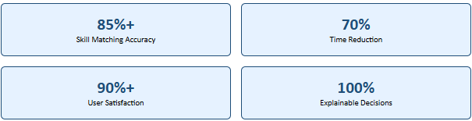

Success Metrics & Evaluation
Evaluation Framework :
Technical: Algorithm performance on test datasets
User: HR professional assessment of utility
Comparative: Performance vs traditional methods
Bias: Fairness assessment across demographics

Slide 9

Methodology & Tools
Follows NASA Systems Engineering Lifecycle and Agile methodology.
Tools used: Jira (planning), GitHub (version control), Teams (collaboration).
Includes unit, integration, and user acceptance testing.
We plan for regular stakeholder feedback and iterative sprint cycles ensure quality.

Slide 10

Current Progress & Implementation
✅ Completed
System design & architecture
Environment setup
Random Forest implementation
Data preprocessing pipeline
🔄 In Progress
Logistic Regression classifier
Ensemble method integration
Qualitative assessment layer
Explainability module

Slide 11

Next Steps
Complete system integration
Web interface development
Testing & optimization
Deployment & validation
🎯
Vision
Transform hiring from
subjective guesswork to
intelligent, fair, and
explainable decisions

Slide 12
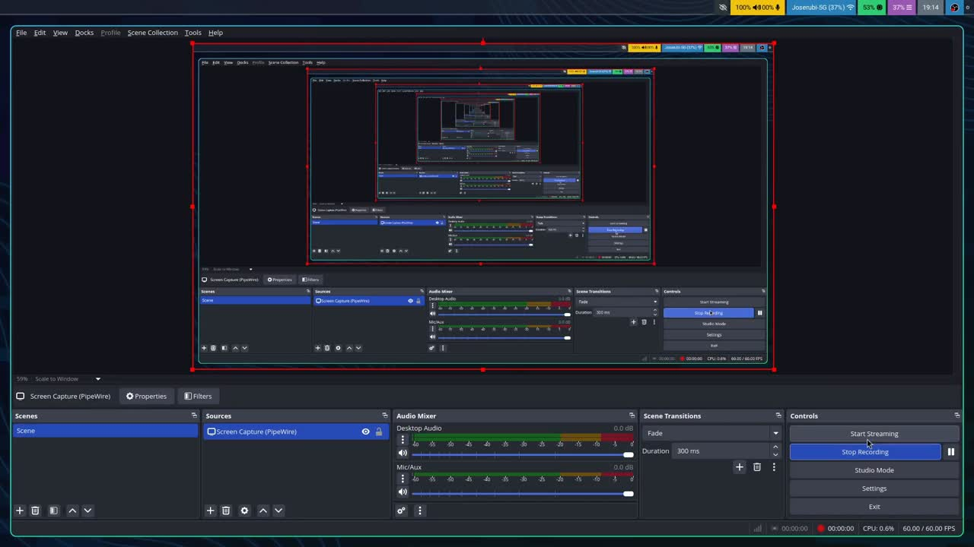
User Tutorial

